Slide 1
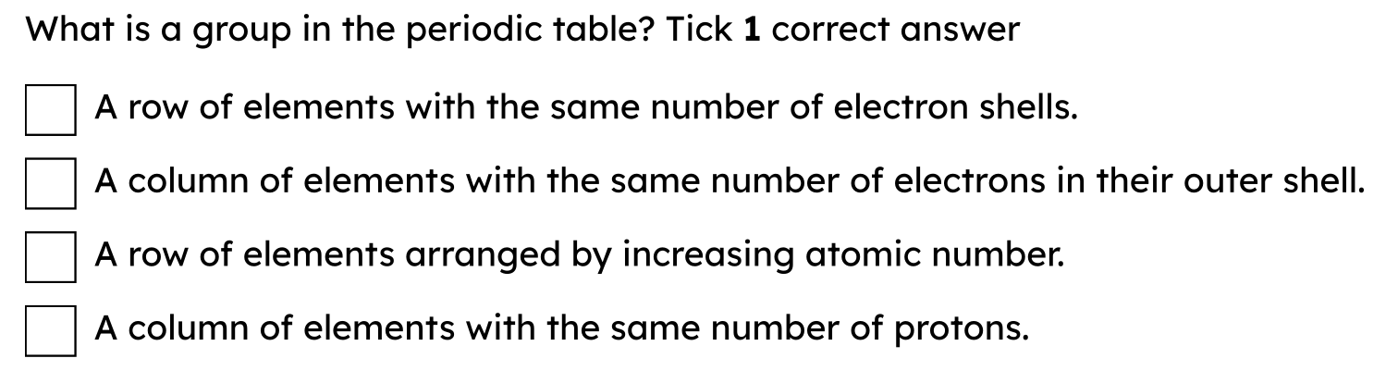
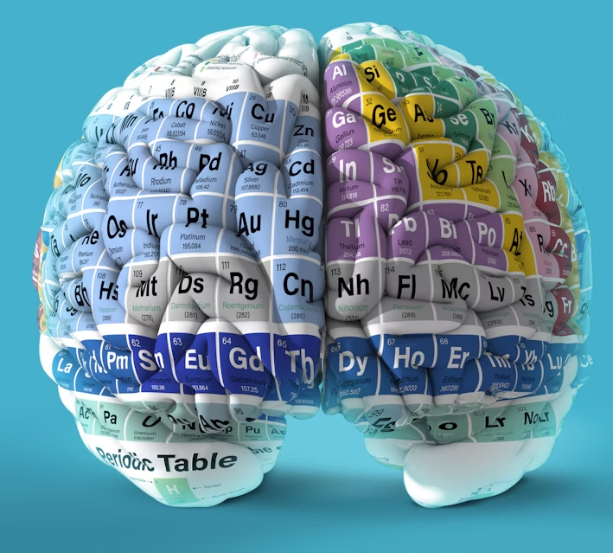

Group 1 elements
Lesson Objectives
To interpret data to describe patterns in properties of the Group 1 elements.
To use patterns to predict properties of Group 1 elements.
Brain teaser
Keywords: Periodic Table, group 1, alkali metals, trends, reactive

Slide 2
Group 1 elements
Meeting | Exceeding | Mastering
I can list the group 1 elements and describe their properties as part of the alkali metals. | I can explain the group 1 elements reactivity in relation to their valence shell electrons | I can explain the trends in the alkali metals as I read up/down the group

Slide 3
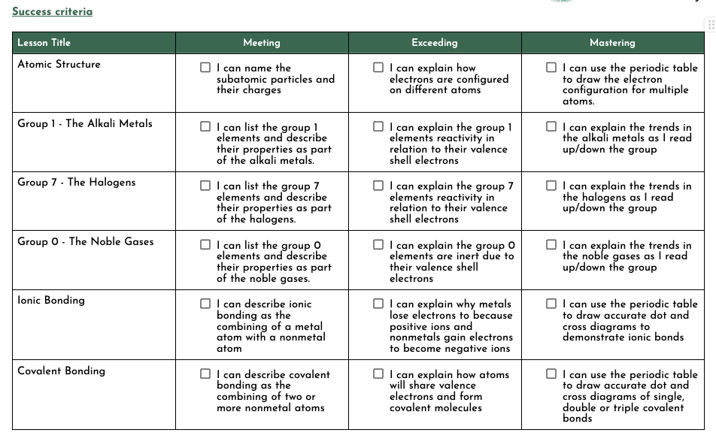

Slide 4
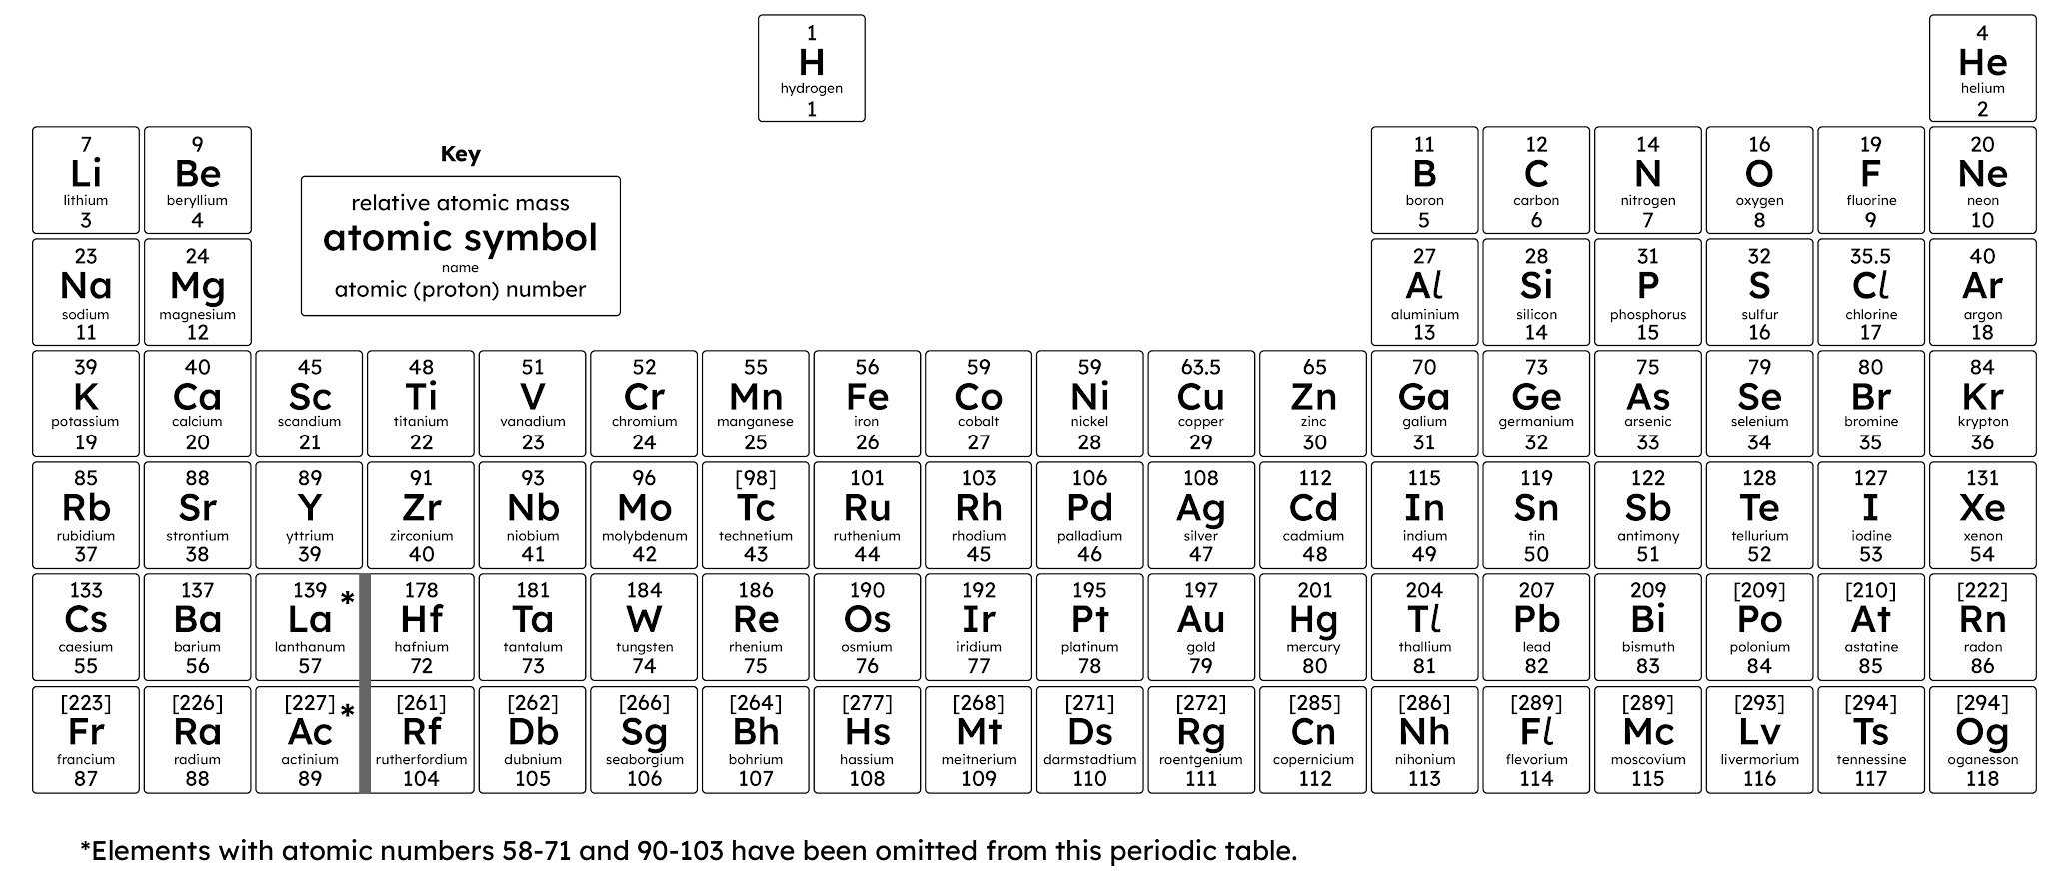
Exploring groups and properties
Elements in the same group have the same number of electrons on their outer shell. This causes the elements in the same group to have similar chemical properties, showing a trend throughout the group.

Slide 5
Exploring groups and properties
Group 1 is known also as the Alkali metals. This group includes lithium, sodium, and potassium.
Na
They have similar chemical and physical properties:
high reactivity
react vigorously with cold water
low melting points
Li
K

Slide 6
Recall: Complete the table
Element | Symbol | Atomic No. | Electron Configuration | Valence Electron
Lithium
Sodium
Potassium
Rubidium |  | 37 | 2,8,8,18,1
Caesium |  | 55 | 2,8,8,18,18,1
Francium |  | 87 | 2,8,8,18,18,32,1

Slide 7
Recall: Complete the table
Element | Symbol | Atomic No. | Electron Configuration | Valence Electron
Lithium | Li | 3 | 2,1 | 1
Sodium | Na | 11 | 2,8,1 | 1
Potassium | K | 19 | 2,8,8,1 | 1
Rubidium | Rb | 37 | 2,8,8,18,1 | 1
Caesium | Cs | 55 | 2,8,8,18,18,1 | 1
Francium | Fr | 87 | 2,8,8,18,18,32,1 | 1

Slide 8
In this activity you will:
record observations on demonstrations of the reactivity of Group 1 elements with water
identify a pattern in behaviour
identify the products formed and some of the product properties.
You will be working scientifically to:
make observations about what you see
predict what you would expect to see for other elements in the same group.
How do Group 1 elements react with water?
Notes:
The metals were handled using forceps. The Group 1 metals were moved with forceps because they would react with the moisture on the skin. There is likely to be a warning to students to stand further back and a reminder of safety glasses and the safety screen.

Slide 9
Group 1 elements - observations
Element | Appearance | How easy is it to cut with a knife? | What happens when it is added to water?
lithium
sodium
potassium
Universal indicator solution is added to the water. Why does the indicator change colour?
After the reaction, a lighted splint makes a squeaky pop. What does this show?

Slide 10

Rubidium reacting with water

Slide 11
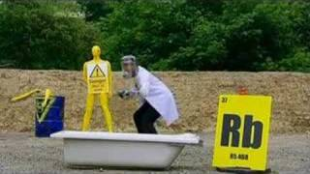
Caesium reacting with water

Slide 12
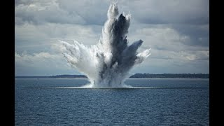
Francium reacting with water
Notes:
1:52 for information to explain that the video is only a depiction for francium
Video is set to play for after the explanation part

Slide 13
Group 1 elements - observations
Element | Appearance | How easy is it to cut with a knife? | What happens when it is added to water?
lithium
sodium
potassium

Slide 14
Group 1 elements - observations
Element | Appearance | How easy is it to cut with a knife? | What happens when it is added to water?
lithium | dull and dark grey on outside, shiny on inside | could be cut by knife | forms a sphere and floats on surface, fizzes
sodium | dull and light grey on outside, shiny on inside | easier to cut by knife | same as above, but faster and may produce yellow flame
potassium | dull and grey on outside, shiny on inside | even easier to cut by knife | same as above, even faster, and produce lilac flame (may explode)

Slide 15


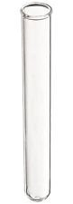
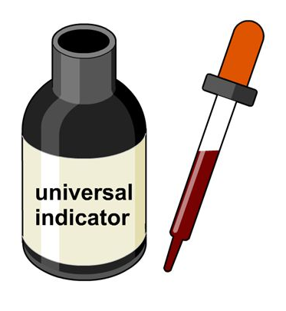
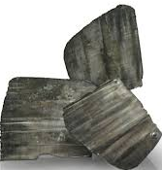
Lithium paper
What does this show?
Alkaline
The reaction produces alkaline hydroxide ions.

Slide 16
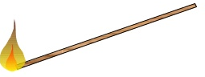
SQUEAKY POP!
What does this show?
Hydrogen
The reaction produces hydrogen that ignites a lighted splint with a squeaky pop

Slide 17
metal hydroxide
metal
+
water
→
+
hydrogen
lithium
+
water
→
lithium hydroxide
+
hydrogen

Slide 18
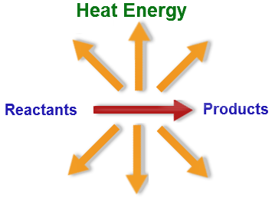
Exothermic reaction
The reactions produce heat energy.
When potassium reacts with water, it produces so much heat that the hydrogen given off catches alight.
What colour was the flame?

Slide 19
Group 1: Alkali metals
ALL
Describe the trend in the reactivity of the elements down Group 1.
MOST
Write the word equation for the reaction between lithium and water.
SOME
Suggest a reason why the alkali metals are stored in oil.

Slide 20

Group 1: Alkali metals
ALL
The metals become more reactive as you go down the group.
MOST
lithium + water → lithium hydroxide + hydrogen
SOME
The metals are highly reactive with water and oxygen in the air, but they do not react with oil. This prevents them from reacting to form compounds, allowing them to remain as pure metals.

Slide 21
Element | Chemical formula | Atomic number | Melting point (℃) | Boiling point (℃)
Lithium | Li | 3 | 180 | 1360
Sodium | Na | 11 | 98 | 900
Potassium | K | 19 | 63 | 777
What is the trend shown in the boiling points of Group 1 elements?
What prediction can you make about the boiling point of rubidium?
How many more electrons than lithium does an atom of sodium have?

Slide 22
Element | Chemical formula | Atomic number | Melting point (℃) | Boiling point (℃)
Lithium | Li | 3 | 180 | 1360
Sodium | Na | 11 | 98 | 900
Potassium | K | 19 | 63 | 777
What is the trend shown in the boiling points of Group 1 elements?
The boiling points decrease, as you go down the group.
What prediction can you make about the boiling point of rubidium?
The boiling point of rubidium will be less than 777℃.
How many more electrons than lithium does an atom of sodium have?
8 more electrons.

Slide 23
acid calcium down hard hydrogen less lithium magnesium more not up potassium reactive soft unreactive sodium oxygen easily oil
The first three elements in Group 1 are ................, ................ and ................ .
The first three elements in Group 1 are lithium, sodium and potassium .

Slide 24
acid calcium down hard hydrogen less lithium magnesium more not up potassium reactive soft unreactive sodium oxygen easily oil
The Group 1 elements are very ................ . They can ................ be cut with a knife.
The Group 1 elements are very soft . They can easily be cut with a knife.

Slide 25
acid calcium down hard hydrogen less lithium magnesium more not up potassium reactive soft unreactive sodium oxygen easily oil
The Group 1 elements are stored under ................ because they are very ................ .
The Group 1 elements are stored under oil because they are very reactive .

Slide 26
acid calcium down hard hydrogen less lithium magnesium more not up potassium reactive soft unreactive sodium oxygen easily oil
When these elements react with water they form the gas ................ .
When these elements react with water they form the gas hydrogen .

Slide 27
acid calcium down hard hydrogen less lithium magnesium more not up potassium reactive soft unreactive sodium oxygen easily oil
The elements are ................ reactive with water as you go ................ the group.
The elements are more/less reactive with water as you go down/up the group.

Slide 28

Thumbs up or down to show ‘true’ or ‘false’ for the following statements.
TRUE OR FALSE

Slide 29

Group 1 elements are metals.

Slide 30

Group 1 elements are hard.

Slide 31
Group 1 elements become less reactive down the group.

Slide 32
Group 1 elements can conduct heat and electricity.

Slide 33
Group 1 elements react with water to produce metal hydroxides and hydrogen.

Slide 34
Group 1 elements' boiling points increase down the group.

